Slide 1

FOODSERVICE
PRODUCT CATALOGUE

Slide 2
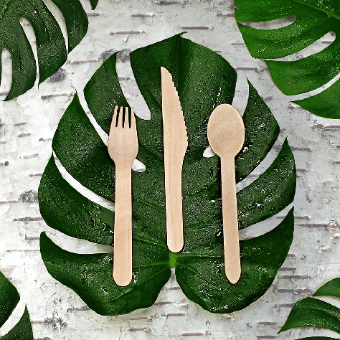
10858143000435
250 Pack - Dispenser Birch Cutlery Foodservice Set - 1 Spoon, 1 Knife, 1 Fork, 1 Napkin- 2/Case
10858143000206
Individually Wrapped Fork - 2 x 500 Unit Dispenser
10858143000404
Individually Wrapped Knife - 2 x 500 Unit Dispenser
10858143000398
Individually Wrapped Spoon - 2 x 500 Unit Dispenser
10858143000428
Sustainable Birch Cutlery- 150 Mixed Pack
(Knife, Fork, Spoon) - 16/Case
BIRCH CUTLERY
MATERIAL: 100% Birch Wood
FSC Certified from sustainably managed forests
CLAIMS:
Home compostable and accepted in every facility
Sharp fork prongs, deeper spoon, serrated knife blade
10834032000182
Greenlid Bulk Birch Fork - Case of 2000
10834032000199
Greenlid Bulk Birch Spoon - Case of 2000
10834032000205
Greenlid Bulk Birch Knife - Case of 2000
10858143000930
Greenlid Mixed Cutlery Pack 24 Units (Knife, Fork, Spoon) - 24/Case
10858143000978
Greenlid Birch Spoons 24 Units - 24/Case
10858143000992
Greenlid Birch Knives 24 Units - 24/Case
10858143000954
Greenlid Birch Forks 24 Units - 24/Case
10834032000762
Greenlid Birch Forks 50 Units - 24/Case
10834032000786
Greenlid Birch Spoons 50 Units - 24/Case
10834032000779
Greenlid Birch Knives 50 Units - 24/Case

Slide 3
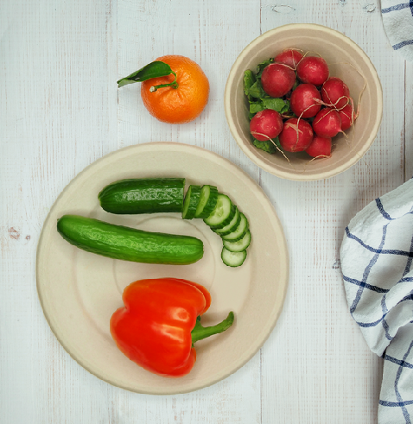
10834032000236
7” Plant Fiber Plate - 1000/Case
10834032000595
10” 3/8 Dinner Plate - 500/Case
10834032000588
8.75” Plant Fiber Plate - 500/Case
PLANT FIBER PLATES
MATERIAL:
Bamboo Fiber, Wood Fiber & Starch
CLAIMS:
• PFAs-free (no fluorinated chemicals) • Compostable
• Oven-safe
• Microwave safe • Leak resistant
• Freezer safe
• Grease resistant
10858143000626
7” Plant Fiber Plate - 12 Units, 24/Case
10858143000640
9” Plant Fiber Plate - 12 Units, 24/Case

Slide 4
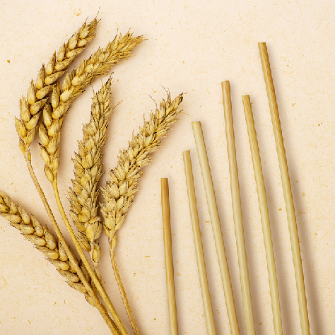
WHEAT DRINKING STRAWS
10858143000220
Wheat Drinking Straws (8”) - Pack of 50 - 44/Case
10858143000367
Wheat Cocktail Straws - Pack of 500 (5”) - Case of 8
10858143000480
Paper Wrapped Wheat Straws (8”) - Pack of 200 - 8/Case
10858143000848
Wheat Drinking Straws (8”) - Pack of 500 - 8/Case
MATERIAL: 100% Wheat Straw
CLAIMS:
• Non-soggy
• Gluten free
• No taste

Slide 5

10858143000381
Bamboo Cup 10oz - Bulk 1000 (Sleeves of 50)
10858143000176
Bamboo Cup 12oz - Bulk 1000 (Sleeves of 50)
10858143000183
Bamboo Cup 16oz - Bulk 1000 (Sleeves of 50)
BAMBOO CUPS AND LIDS
MATERIAL:
Bamboo Fiber, Wood Fiber & Starch
CLAIMS:
• PFAs-free (no fluorinated chemicals) • Compostable
• Oven-safe
• Microwave safe • Leak resistant
• Freezer safe
• Grease resistant
10858143000244
90mm Plant Fiber Coffee Cup Lids (Fits 10oz, 12oz, 16oz cups) 1000/Case
10858143000237
Bamboo Cup 16oz - 12 Pack 10/Case
10834032000243
Bamboo Cup 12oz with Lid 12 Pack - 10/Case

Slide 6
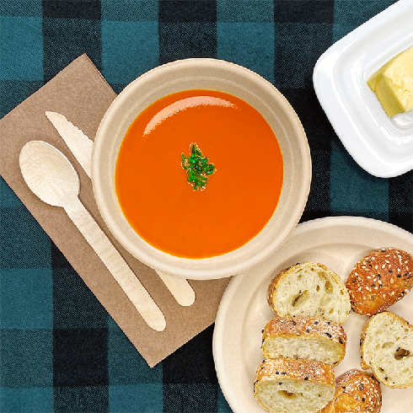
PLANT FIBER BOWLS
MATERIAL:
Bamboo Fiber, Wood Fiber & Starch
CLAIMS:
• PFAs-free (no fluorinated chemicals) • Compostable
• Oven-safe
• Microwave safe • Leak resistant
• Freezer safe
• Grease resistant
10834032000069
500mL (17oz) Plant Fiber Bowl -500/Case
10834032000076
Fiber Lids for 500mL (17 oz Bowl) - 500/Case
10858143000671
Greenlid Plant Fiber 12oz Bowl - 12 Pack - 24/Case

Slide 7
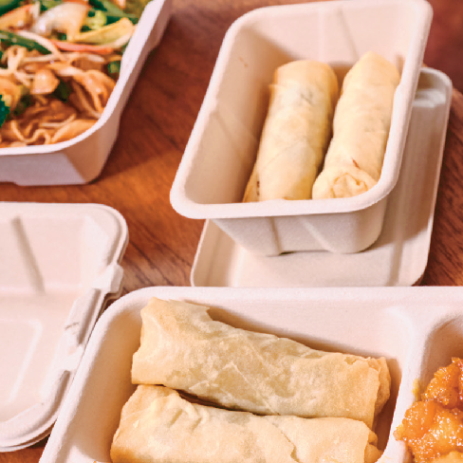
PLANT FIBER TAKEAWAY
CONTAINERS & LIDS
MATERIAL: Bamboo Fiber, Wood Fiber & Starch
CLAIMS:
• PFAs-free (no fluorinated chemicals) • Compostable
• Oven-safe
• Microwave safe • Leak resistant
• Freezer safe
• Grease resistant
10834032000142
Fiber Lids for Oval Take Out Container - 500/Case
10834032000106
850mL (28oz) Oval Take Out Container - 500/Case
10834032000113
800mL (27oz) 2-Compartment Oval Take Out Container - 1000/Case

Slide 8
ADDITIONAL PRODUCTS
10858143000916
Greenlid Compostable 12- Person Party Pack - Case of 12
10858143000725
1/8 Fold Recycled Paper Dinner Napkins 100 Pack - Case of 20
10858143000756
1/4 Fold Recycled Paper Cocktail Napkins 100 Pack - Case of 32
10858143000695
Greenlid EcoCooler
32 Can Capacity - Case of 10

