Slide 1


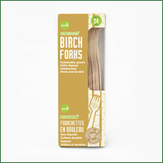


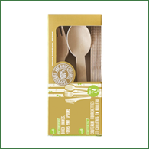
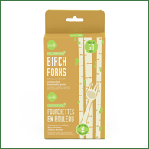
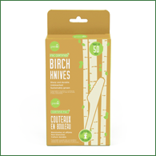
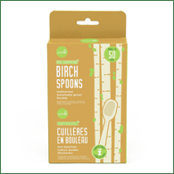
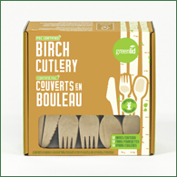
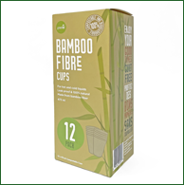

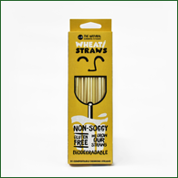


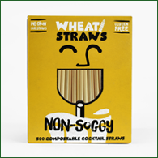

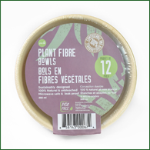
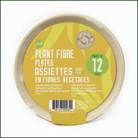



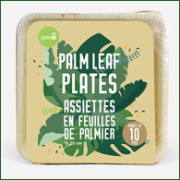
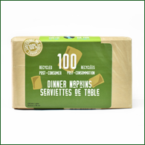
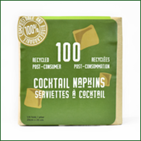

RETAIL OFFERING
BIRCH FORKS
(24 Pack)
UPC: 858143000957
CAN GCF101-24_12x2
BIRCH KNIVES
(24 Pack)
UPC: 858143000995
CAN GCK101-24_12x2
BIRCH SPOONS
(24 Pack)
UPC: 858143000971
CAN GCS101-24_12x2
BIRCH CUTLERY
(24 Mixed Pack)
UPC: 858143000933
CAN GCM101-24_12x2
BIRCH FORKS
(50 Pack)
UPC: 834032000765 CAN GCF101-50_24
BIRCH KNIVES
(50 Pack)
UPC: 834032000772
CAN GCK101-50_24
BIRCH SPOONS
(50 Pack)
UPC: 834032000789
CAN GCS101-50_24
BIRCH CUTLERY
(150 Mixed Pack)
UPC: 858143000421 CAN GCM101-150_16
BAMBOO CUPS
16oz (12 Pack)
UPC: 858143000230 CAN BPLA_16-12_10
BAMBOO CUPS
& PLANT FIBER LIDS
12oz (12 Pack)
UPC: 834032000246
CAN BPLA_LID_12-12_10
WHEAT STRAWS
8” (50 Pack)
UPC: 858143000223
CAN RS101-50_44
WHEAT STRAWS
8” (100 Pack)
UPC: 858143000810
CAN RS101-100_24
WHEAT STRAWS
Individually Wrapped
8” (200 Pack)
UPC: 858143000483
CAN_RS103-200_8
COCKTAIL STRAWS
5” (500 Pack)
UPC: 834032000710
CAN RS102-500_8
WHEAT STRAWS
8” (500 Pack)
UPC: 858143000841
CAN RS101-500_8
PLANT FIBER BOWLS
12oz (12 Pack)
UPC: 858143000674
CAN GPF-B12-12_24
PLANT FIBER PLATES
7” (12 Pack)
UPC: 858143000629
CAN GPF-P7-12_24
PLANT FIBER PLATES
9” (12 Pack)
UPC: 858143000643
CAN GPF-P9-12_24
PALM LEAF BOWLS
5.5” (10 Pack)
UPC: 858143000896 CAN GPL-B5-10_8
PALM LEAF PLATES
6” (10 Pack)
UPC: 858143000858
CAN GPL-P6-10_16
PALM LEAF PLATES
8” (10 Pack)
UPC: 858143000872
CAN GPL-P8-10_16
DINNER NAPKINS
(100 Pack)
UPC: 858143000728
CAN GND-100_20
COCKTAIL NAPKINS
(100 Pack)
UPC: 858143000759
CAN GNC-100_32

