Slide 1
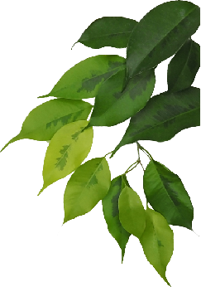
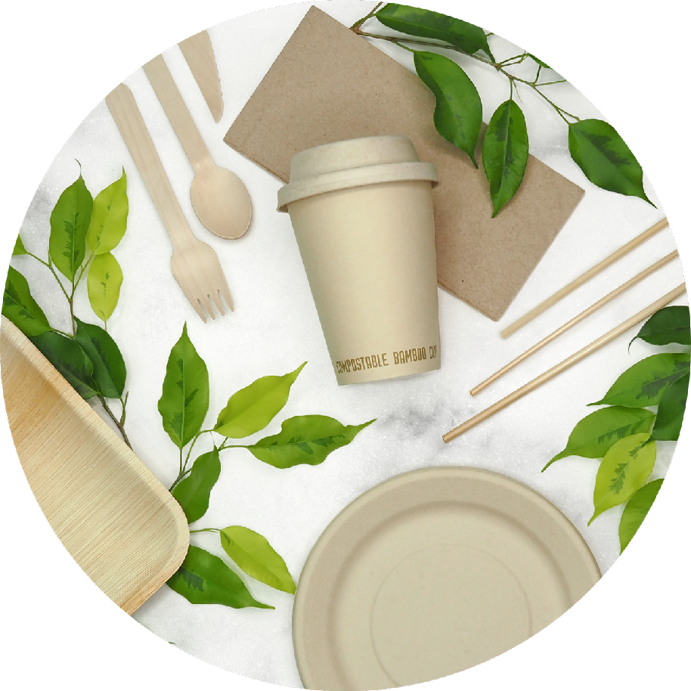
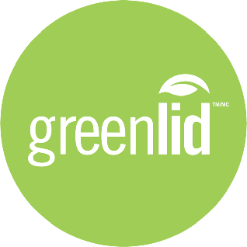
100% COMPOSTABLE TABLEWARE SOLUTIONS

Slide 2
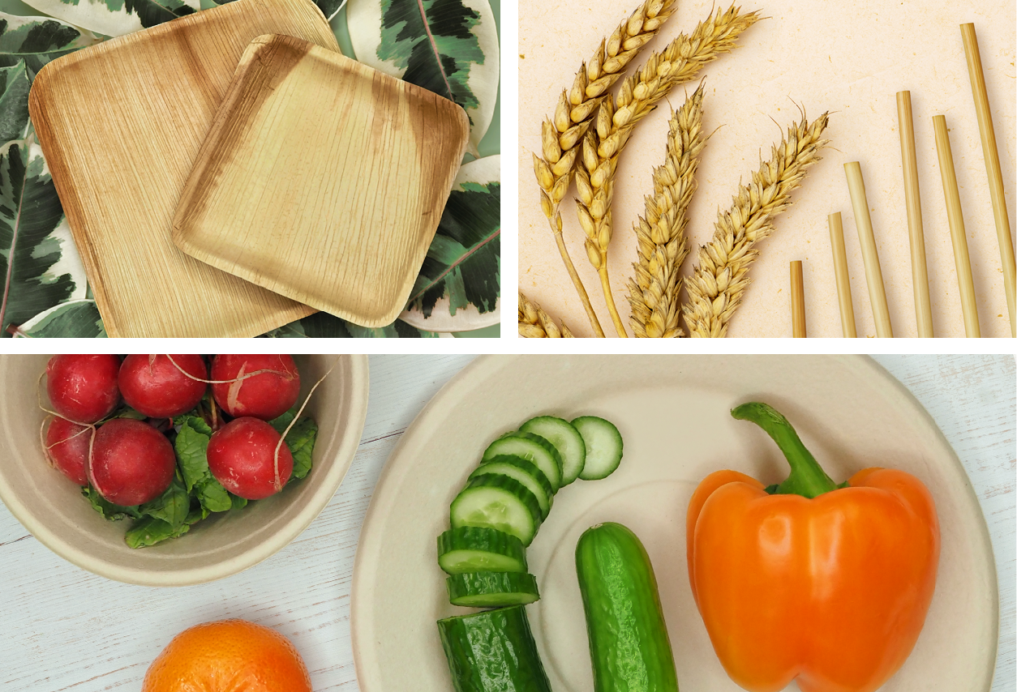
Greenlid offers a full range of sustainable tableware solutions made from natural materials that are fully compostable, biodegradable and 100% free of harmful PFAs.
Recognized as a leading manufacturer of compostable disposable products in North America, with private-label products in over 14,000 retail stores and Greenlid-
branded products in 10,000+ restaurants and retailers.
Make the switch to compostable products today!
Greenlid takes the guesswork out of single-
use plastic regulations, as our products are
outside of all current and future bans!

Slide 3
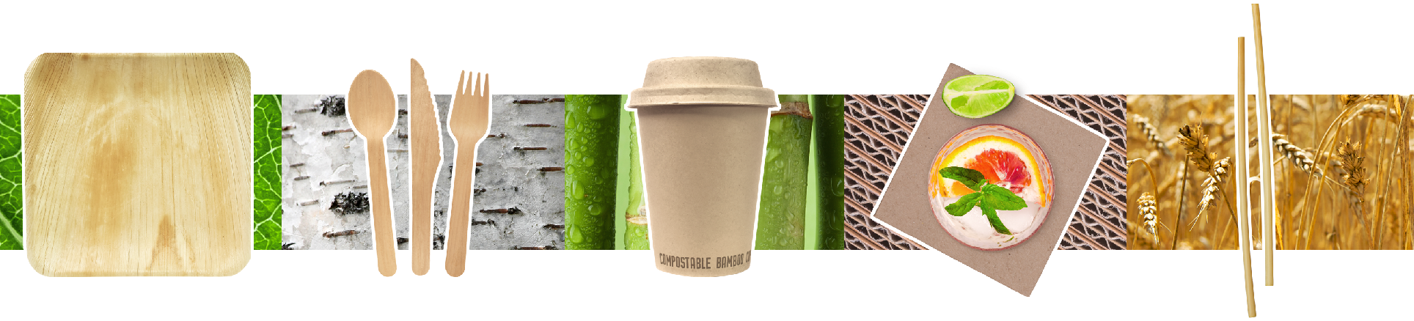
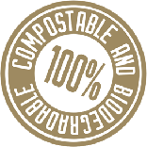
OUR MATERIALS
PALM LEAF
Our Palm Leaf plates and bowls are made from fallen dry leaves, which are otherwise wasted. The palm leaf production process does not involve any additives, synthetic materials, or strengthening agents. It is a 100% chemical-free product.
BIRCH
All of Greenlid's disposable cutlery is made from birch. Birch is a sustainable and durable choice that has less impact on the environment than alternative hardwoods, which have lengthier growing periods. All of our birch comes from Sustainably Managed Forests.
PLANT FIBRE
Plant fibre is a raw material obtained after wheat and bamboo have been harvested. The strong, fibrous pulp is molded into plates, bowls, cups, and other products like our foodservice and takeout containers. Unlike paper products, our plant-fibre products don’t require the cutting down of trees.
RECYCLED PAPER
Greenlid’s recycled paper napkins are made from 100% post-consumer recycled content and help eliminate the need to harvest virgin materials. Our napkins don’t use harmful bleaching agents, so you reduce the number of chemicals introduced into your home.
WHEAT STALK
The most natural and eco-friendly
drinking straws in the world, Greenlid Wheat Straws are grown, not manufactured. They break down naturally and will never end up harming wildlife or polluting the planet. We use a wheat harvest by-product that is simply cut, sorted, and rinsed three times with boiling distilled water.

Slide 4
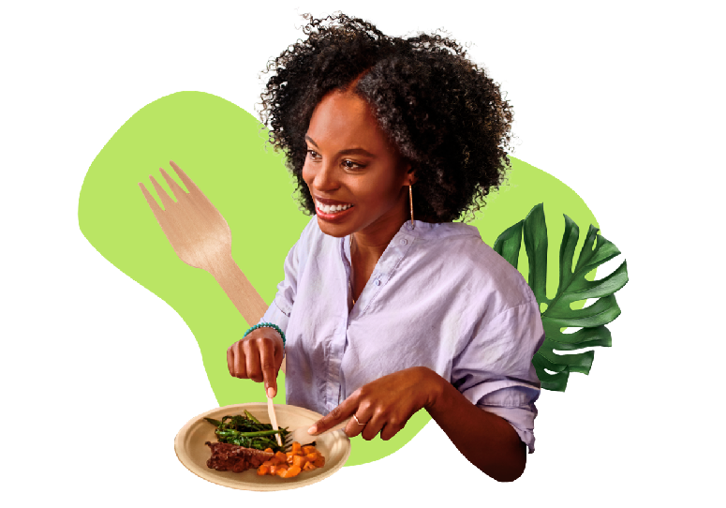



100% FREE OF PFAS
AND FLUORINATED CHEMICALS
PFAs (polyfluoroalkyl and perfluoroalkyl substances) are chemicals that are added to food packaging to provide grease and water resistance. With very similar properties to Teflon, PFAs and other fluorinated chemicals are considered “forever chemicals” as they accumulate in the environment. Since these chemicals can permeate food, air, soil and water, they pose a growing threat to our health. Greenlid’s products are free of fluorinated chemicals and PFAs, unlike the vast majority of other molded fibre tableware and foodservice products.
The scrutiny on PFAs is finally reaping some real-world changes. BPI (Biodegradable Products Institute) has implemented a new standard for restricting PFAs from its certification. Many big-name brands have committed to removing PFAs from their packaging, but will not achieve their goal until at least 2025. By choosing Greenlid, you don’t have to wait!

Slide 5
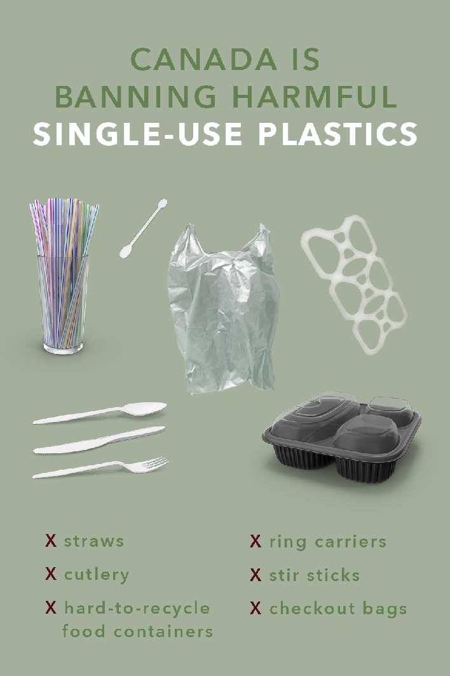
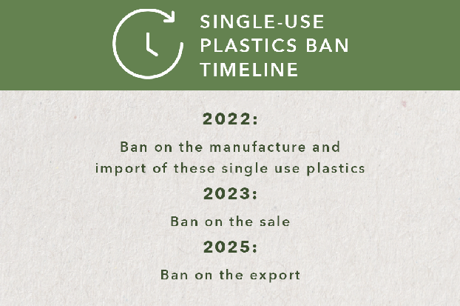
“
We promised Canadians we would deliver a ban on single-use plastics. Today, that’s exactly what we’ve done. By the end of the year, you won’t be able to manufacture or import these harmful plastics. After that, businesses will begin offering the sustainable solutions Canadians want, whether that’s paper straws or reusable bags. With these new regulations, we’re taking a historic step forward in reducing plastic pollution, and keeping our communities and the places we love clean.
- The Honourable Steven Guilbeault, Minister of Environment and Climate Change
”
In Canada, up to 15 billion plastic checkout bags are used every year and approximately 16 million straws are used daily. Single-use plastics like these make up most of the plastic litter found on shorelines across Canada.
Sales of single-use flexible plastic straws will be restricted as of December 2023. Exceptions to the ban on straws allow single-use plastic flexible straws to remain available for people in Canada who require them for medical or accessibility reasons. This includes for use at home, in social settings, or in healthcare settings, such as hospitals and long‑term care facilities. All other types of single-use plastic straws will be prohibited.
Moving toward a more circular economy for plastics could reduce carbon emissions by 1.8 megatonnes annually, generate billions of dollars in revenue, and create approximately 42,000 jobs by 2030.

Slide 6
TRULY COMPOSTABLE VS “COMPOSTABLE” PLASTIC
Compostable plastics are commonly used for disposable items, such as packaging, cutlery, and takeout containers. There are several factors that make compostable plastics problematic in real-life settings. While making purchase decisions, consumers must beware of “greenwashing”.
Biodegradable and compostable plastics don’t mix with recyclable plastics. When compostable plastics are recycled into a blue bin, they can contaminate and degrade regular recyclable items. Since it’s difficult to separate traditional recyclable plastics from biodegradable plastics (they look almost identical), they are often missed. This can create an extra step for the recycling plant to sort and it can contaminate the other recycled products in the process.
Compostable plastic will not biodegrade in a landfill. Many compostable plastics are designed to decompose in an industrial composting system, however, this rarely happens to them. Many compostable plastics are usually discarded in our waste bin (which means they end up in a landfill) and cannot properly compost because these special plastics need air, moisture, and sunlight to break down properly. In a landfill setting, it can take decades or even centuries for the items to fully break down.
Some compostable plastics can still contain harmful chemicals. Not all compostable plastics are free of harmful chemicals like lead, cadmium, BPA and phthalates. Unless further tested, or properly stated on the packaging - it’s hard to know what exactly is in your compostable plastic product. Unless a compostable plastic item ends up in a perfect laboratory composting setting, it can cause more harm to the environment than good.

Slide 7
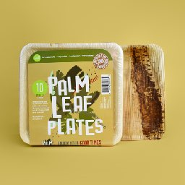
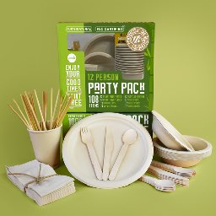
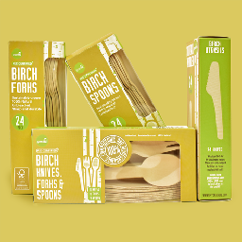
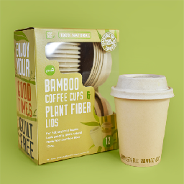
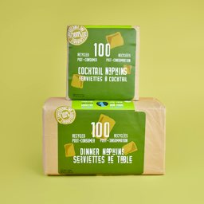
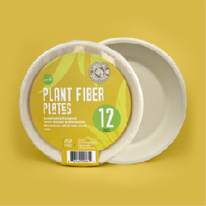
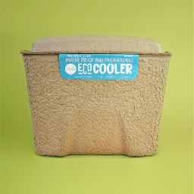
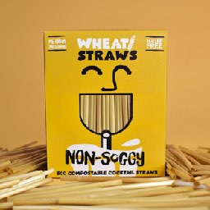
PALM LEAF TABLEWARE
Material: 100% palm leaf
Oven & microwave safe
Leak proof, oil resistant
-6” plates 10 pack
-8” plates 10 pack
-5.5” bowls 10 pack
12 PERSON PARTY PACK
Contains:
12- 9” plant fibre plates
12- 12oz plant fibre bowls
12- birch forks, knives & spoons
12- 100% recycled content napkins
24- wheat drinking straws
12- 12oz bamboo fibre cups
BIRCH CUTLERY
Material: 100% birch wood
FSC Certified from sustainable forests
Sharp fork prongs, deeper spoon,
serated knife blade
-24 packs (knife, fork, spoon, mixed)
-150 count mixed packs
BAMBOO CUPS
Material: bamboo fibre
(+ thin layer PLA)
Oven & microwave safe
Leak proof, oil resistant
-Tight-gripping lid
-12oz with lid 12 pack
-16 oz 12 pack
RECYCLED PAPER NAPKINS
Material: 100% post-consumer
Recycled paper
Unbleached
Packaged in Kraft paper
-Dinner napkins 1/8 fold
-Cocktail napkins 1/4 fold
PLANT FIBRE TABLEWARE
Material: plant fibre
Oven, microwave & freezer safe
Leak proof, oil resistant
-7” dessert plate
-8.75” dinner plate
-12 oz bowl
ECO COOLER
Material: 100% recycled cardboard
Proprietary bio-based leak proof additive
30 can capacity
Fill up and compost the entire container
WHEAT DRINKING STRAWS
Material: 100% wheat stalk
Non-soggy
Gluten free, no taste
-5” cocktail straws 500 pack
-8” drinking straws 500 pack
-8” drinking straws 100 pack
-8” drinking straws 50 pack

