Slide 1
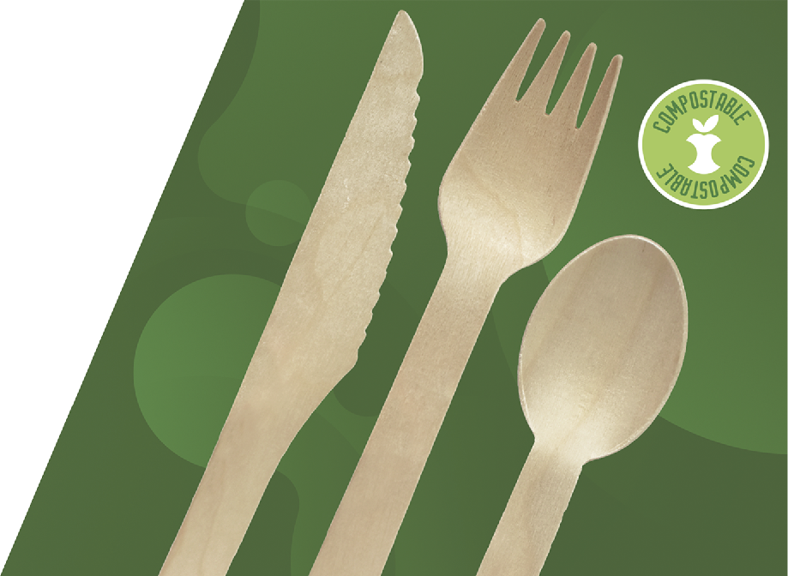

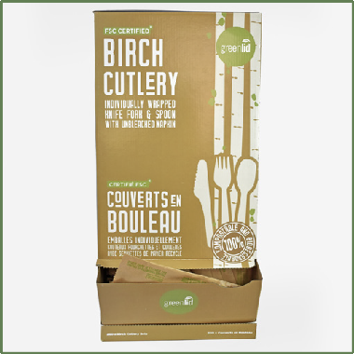
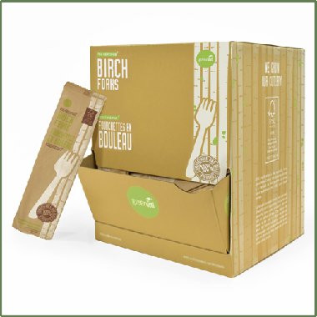
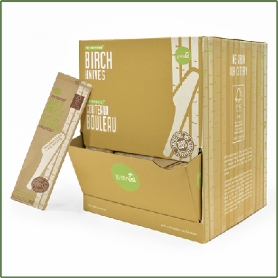
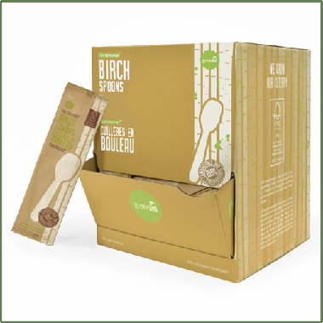
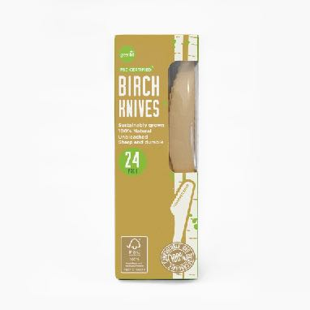
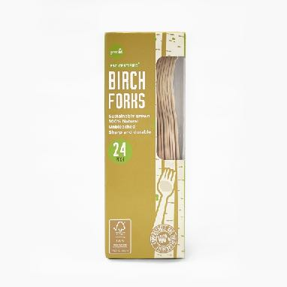
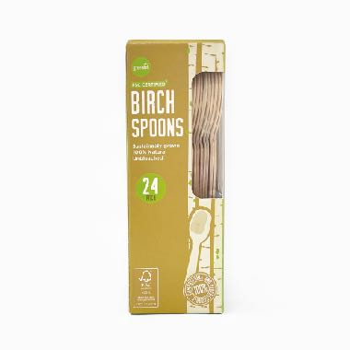
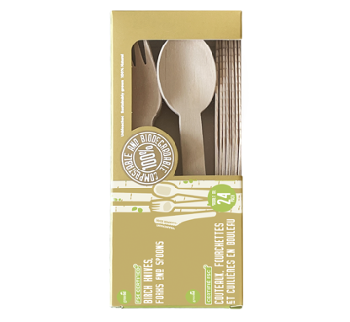
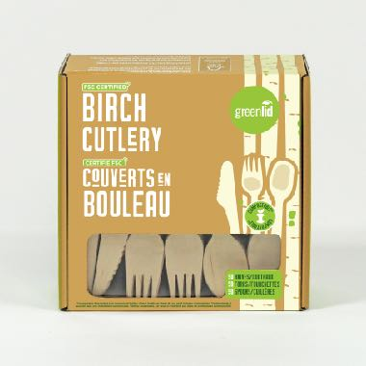
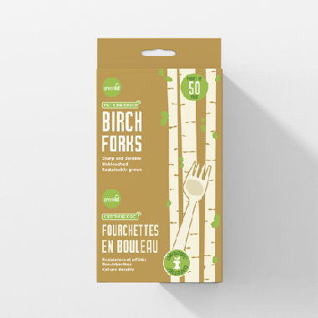
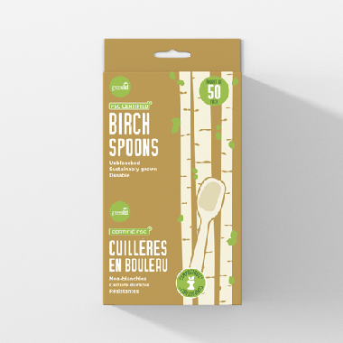
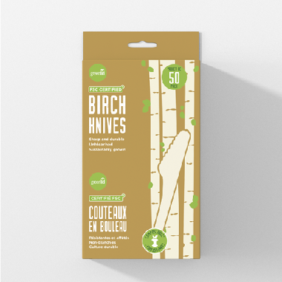
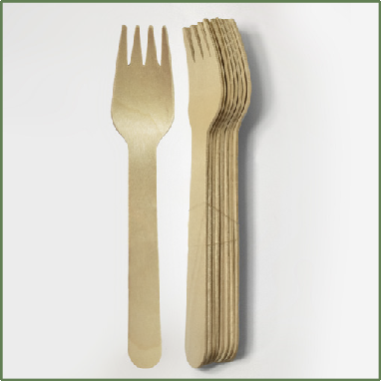
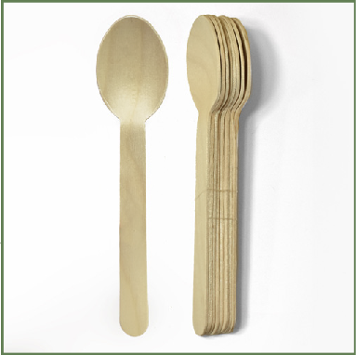
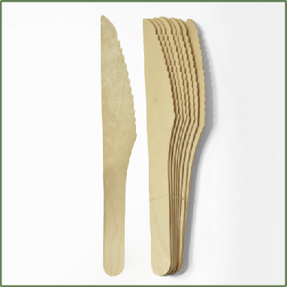
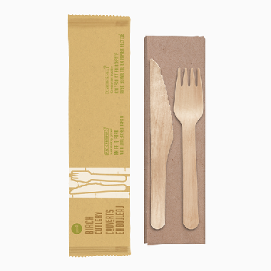

BIRCH CUTLERY
CLAIMS:
• Home compostable and accepted in every facility
• Sharp fork prongs, deeper spoon, serrated knife blade
• Strong and sturdy
• Flexible and microwavable
• Wrapped in recyclable kraft paper
• Box is recyclable
• Compliant with all federal and local plastic bans
• PFA and PLA Free
Material: 100% Birch Wood
FSC certified and sustainably grown
The Forest Stewardship Council ensures that all birch used has been sustainably grown with the planet as a priority
10858143000435
250 Pack - Dispenser Birch Cutlery Foodservice Set - 1 Spoon, 1 Knife, 1 Fork, 1 Napkin- 2/Case
10858143000206
Individually Wrapped Fork - 2 x 500 Unit Dispenser
10858143000404
Individually Wrapped Knife - 2 x 500 Unit Dispenser
10858143000398
Individually Wrapped Spoon - 2 x 500 Unit Dispenser
10858143000992
Greenlid Birch Knives
24 Units - 24/Case
10858143000954
Greenlid Birch Forks
24 Units - 24/Case
10858143000978
Greenlid Birch Spoons
24 Units - 24/Case
10858143000930
Greenlid Mixed Cutlery Pack
24 Units (Knife, Fork, Spoon)
- 24/Case
10858143000428
Sustainable Birch Cutlery-
150 Mixed Pack
(Knife, Fork, Spoon) -
16/Case
10834032000762
Greenlid Birch Forks
50 Units - 24/Case
10834032000786
Greenlid Birch Spoons
50 Units - 24/Case
10834032000779
Greenlid Birch Knives
50 Units - 24/Case
10834032000182
Greenlid Bulk Birch Fork -
Case of 2000
10834032000199
Greenlid Bulk Birch Spoon -
Case of 2000
10834032000205
Greenlid Bulk Birch Knife - Case of 2000
10834032000793
Birch Cutlery Foodservice Set - 1 Knife, 1 Fork, 1 Napkin- 500/case

